Slide 1
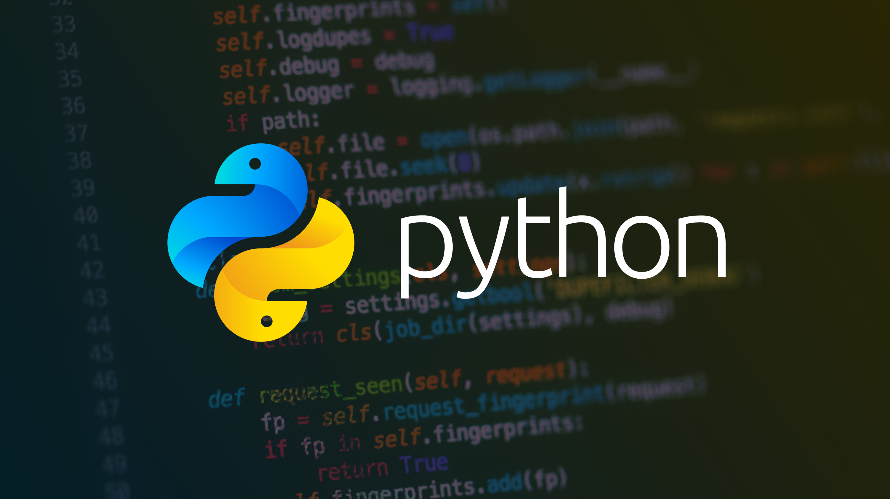
basics

Slide 2

Agenda
Day 1
Your first python program
Working with variables
Getting user input
Data types and type conversions
01
Sample Text
This is an agenda item that will be used as a template for all other agenda items.
02
Sample Text
This is an agenda item that will be used as a template for all other agenda items.
03

Slide 3
01 Setting Up your Dev Environment
02 Your First Python Program
03 Getting Input from a User
04 Working With Strings
05 Working With Operators
06 If Statements
07 While Loops
08 Lists
09 For Loops
10 Range Function
11 Tuples/Dictionaries
12 File IO
13 Functions
14 Error Handling

Slide 4
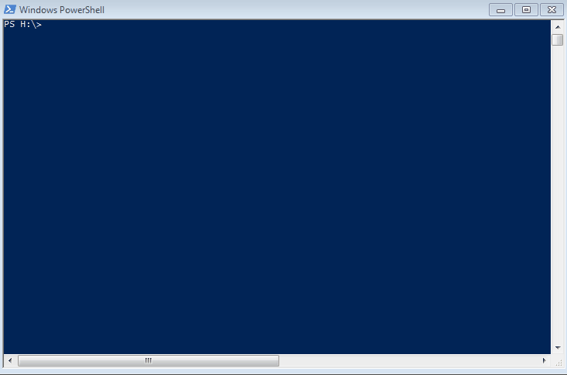
Setting Up Your Development Environment
Installing Python
@Home visit https://www.python.org/ and download and install python
@JPMC visit
http://go/software then search for and install python OR
http://go/devshell and install (devshell must be installed first)
Installing an IDE
Visual Studio Code – Lightweight IDE (http://go/software ) then add Python extension by Microsoft
IDEA IntelliJ – JPMC standard for Java (http://go/devshell )
Visual Studio Full – JPMC standard for .NET (http://go/software )
@Home – Install any of the following
VS Code (https://code.visualstudio.com/download ) then add Python extension by Microsoft
PyCharm Community (https://www.jetbrains.com/pycharm/download/#section=windows )
Devshell installation

Slide 5
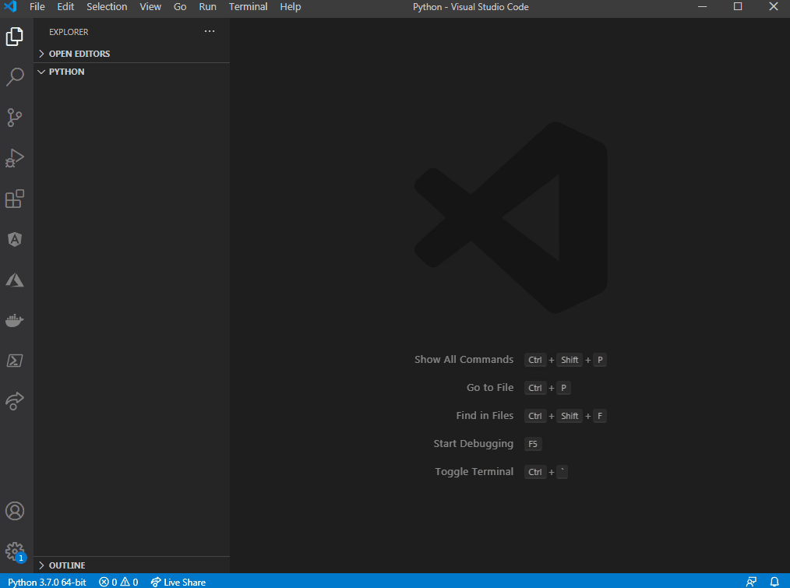
Your First Python Program
The infamous “Hello World” program
print("hello world")
Print Function
Prints a string or sequence of characters (textual
data) to the screen. When you work with string data,
always put the string inside quotes.
Print can also print objects. Objects are converted
to a string before being written to the screen.
As you learn more python the output you print to the screen gets more advanced.
Notes:
String = data type that includes a sequence of characters or textual data.

Slide 6
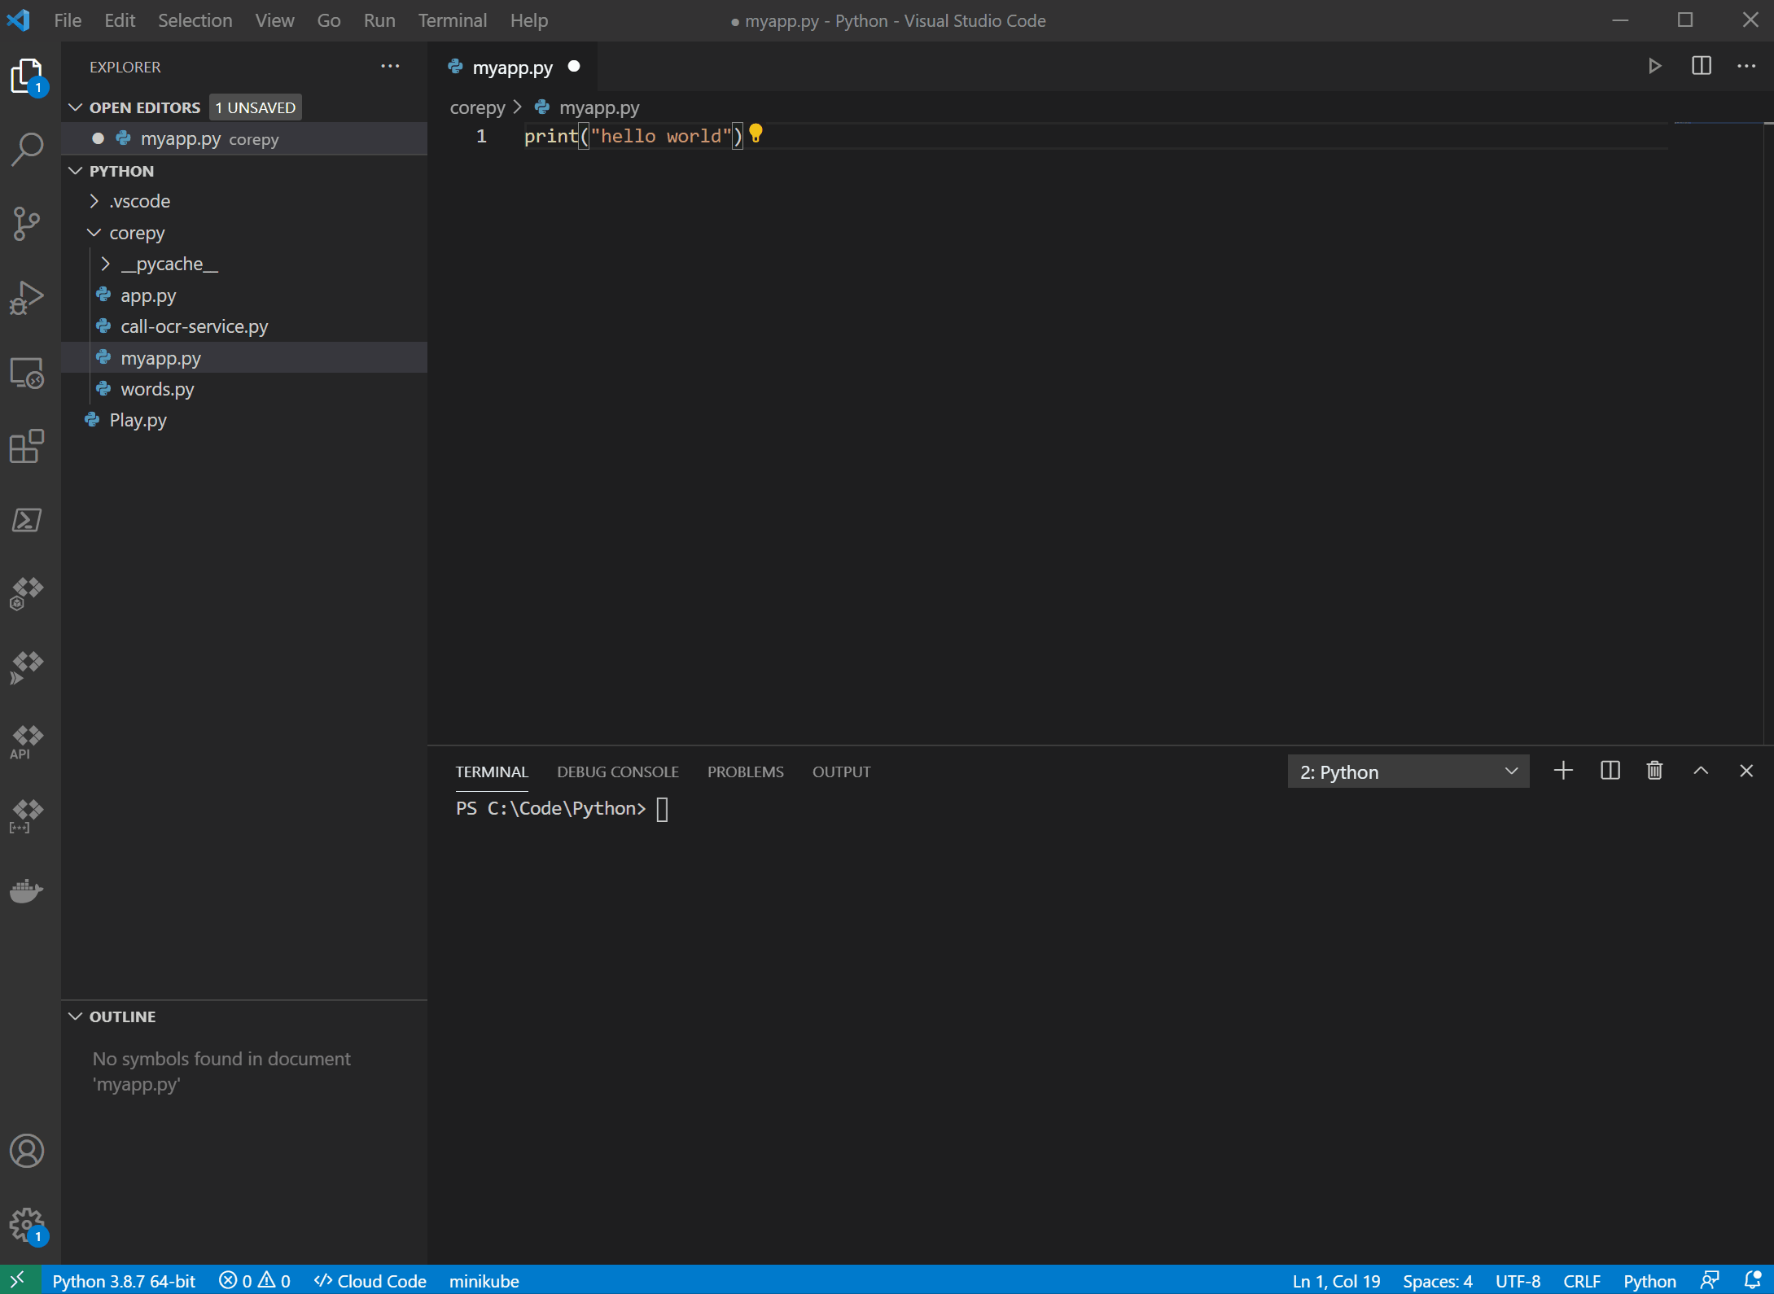
Working With Variables
What are variables?
Variables are names used to hold one or more values. Instead of repeating these values in multiple places in your code, the variable can be used to hold values. In python, variables are case-sensitive and must always be expressed in the same format that was used when the variable was defined.
Lets modify our hello world code…
age = 20 print(age)
Results
The value 20 is stored in a variable named age.
The print function prints the value of the age variable.
Notes:
Age is of int or integer data type

Slide 7
Variables Continued
Add more variables
Let's add a few more variables and print them…
age = 20
print(age)
price = 19.95
first_name = "Darron"
is_online = False
print(price)
print(first_name)
print(is_online)
Run your updated program and you should see additional output for the newly created variables.
NOTE: is_online is a variable of type Boolean. Boolean values are either True or False.

Slide 8
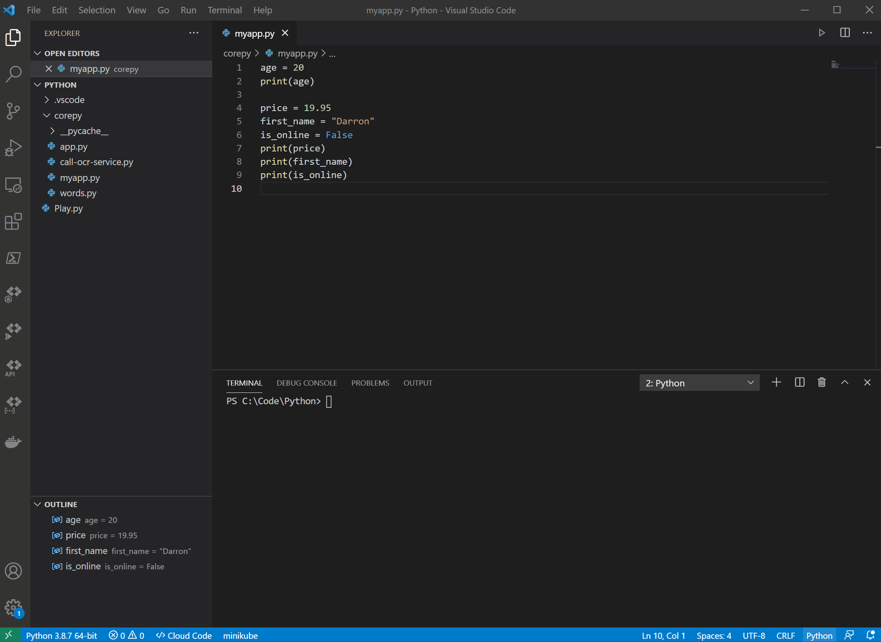
Exercise - Variables
Hospital Check-in Program
Write a program that will:
Check-in a patient named John Smith
He’s 20 years old
He is a new patient
Declare the variables to store these values and print the output.

Slide 9
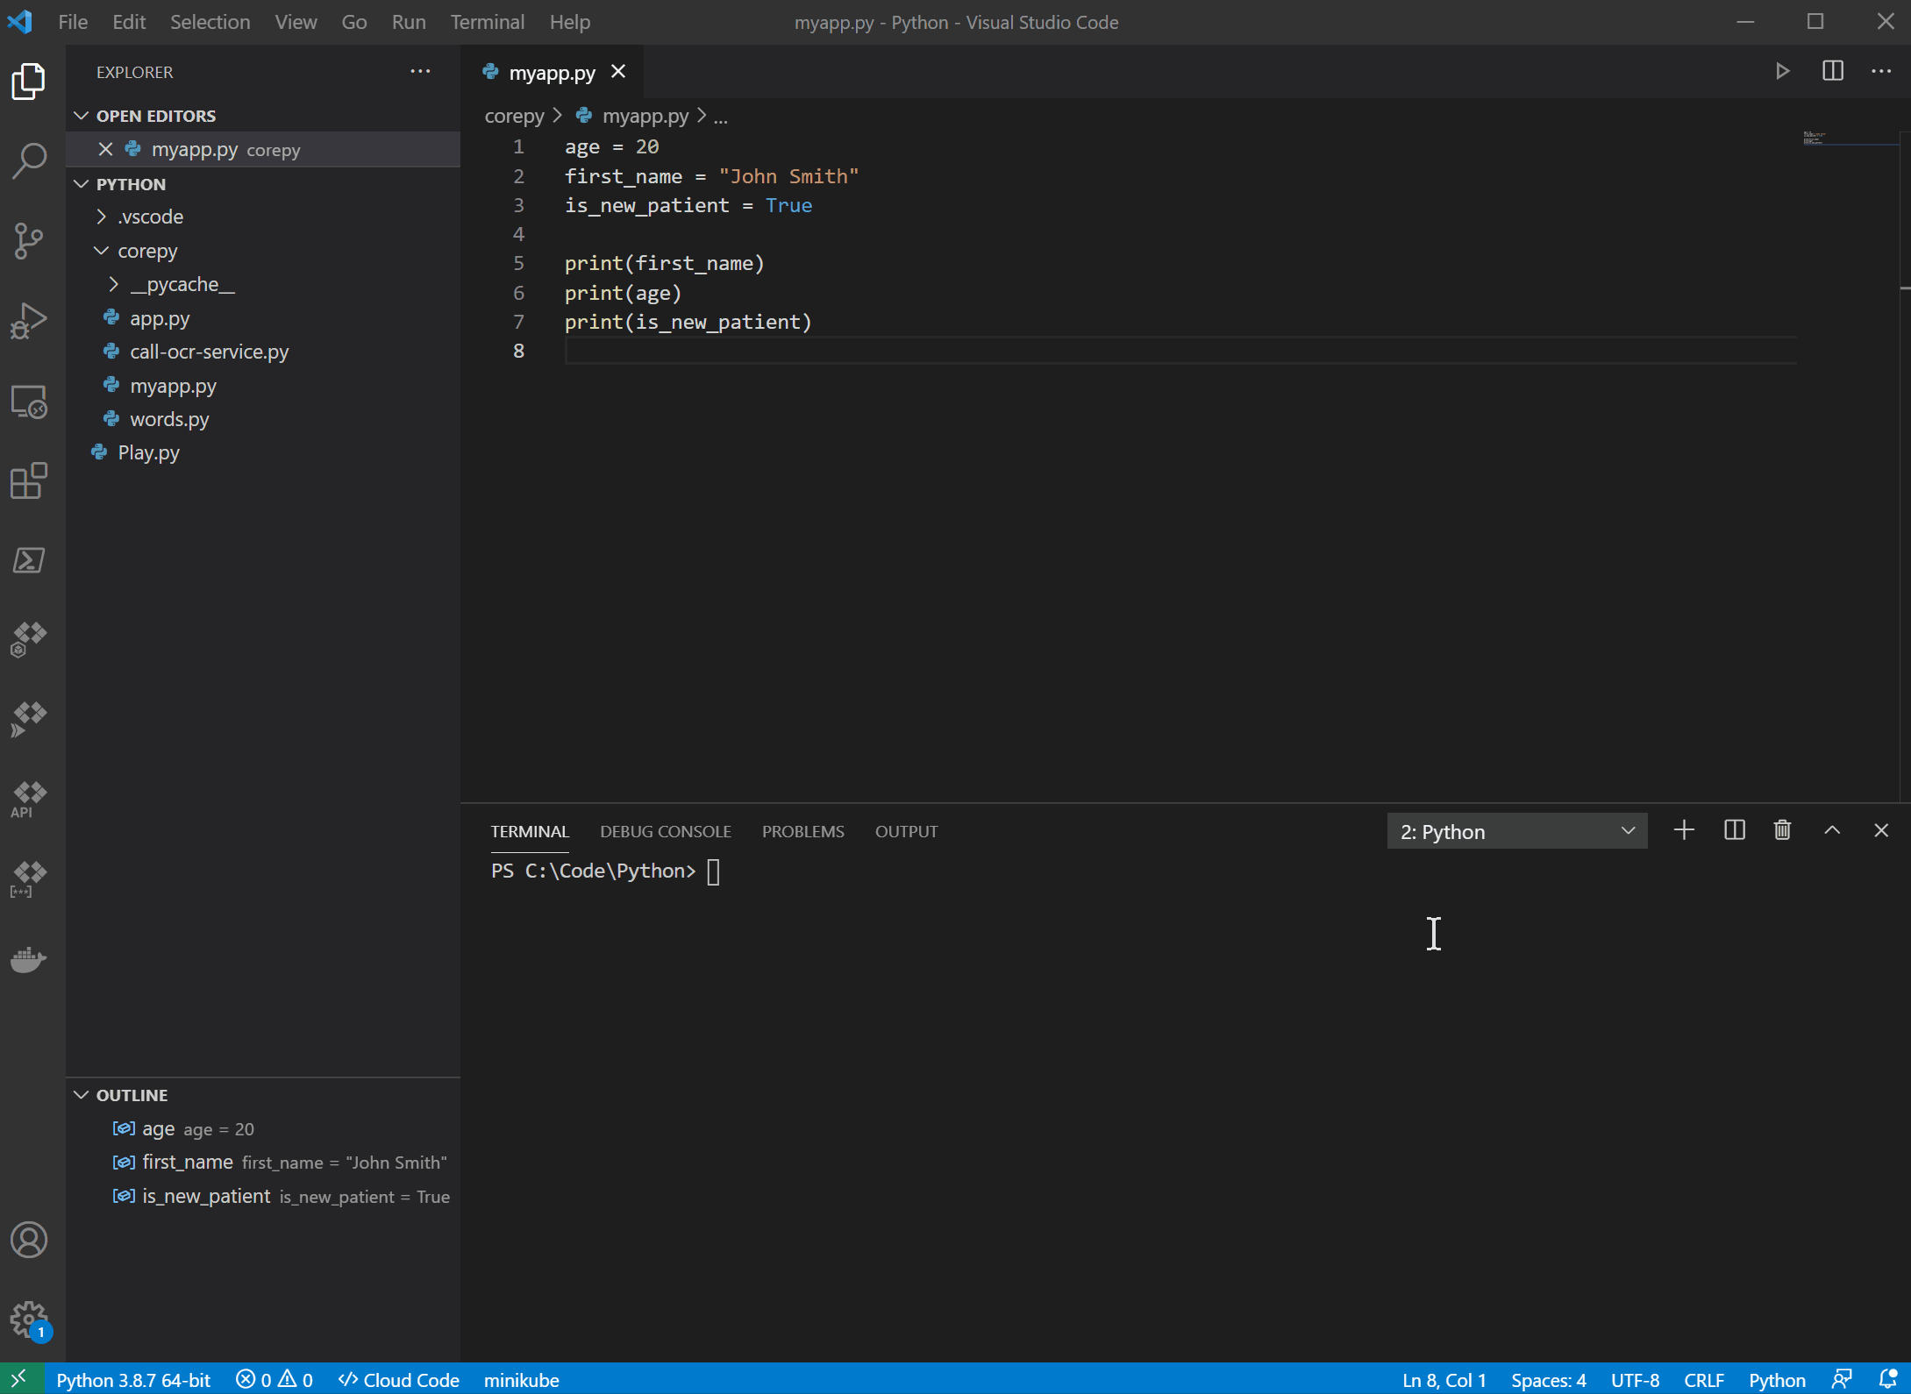
Getting Input from a User
Input Function
The input function is used to prompt the user.
input("What is your name?")
When the enter key is pressed, the input function returns the value entered as string (remember string data type).
Let's update our program to accept input from the user and store the value entered in the variable name.
name = input("What is your name?")
Next, let’s add a print statement:
print("Hello " + name)
Results
When you run this program, you’ll be prompted to enter your name. After pressing enter, a message will be output as follows:
Hello <name entered here>

Slide 10
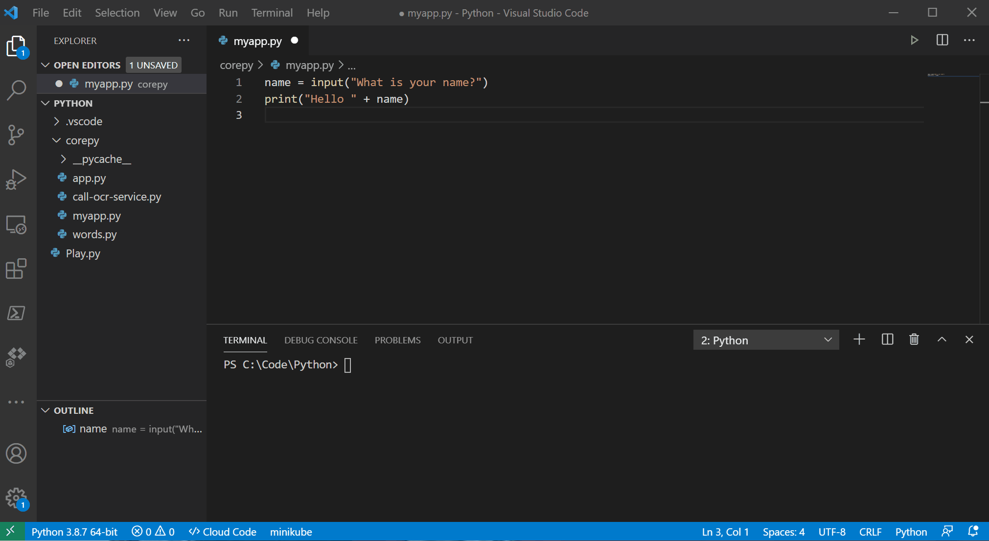
Data Types & Type Conversions
Convert one data type to another
In python you have three types of data.
numbers, strings, and booleans
When working with numbers there are two types:
int – Integers (whole numbers like 20)
float – Floats (decimal numbers like 20.1)
When working with Booleans you have two possible values:
boolean – Booleans can only be True or False
NOTE: True and False are case-sensitive
Let’s do an exercise where we calculate age using the current year minus birth year.
birth_year = input("Enter your birth year: ") age = 2021 - birth_year print(age)
Results
When you run the above program you get a TypeError after entering your birth year.
TypeError: unsupported operand type(s) for -: 'int' and 'str’ So what happened?

Slide 11
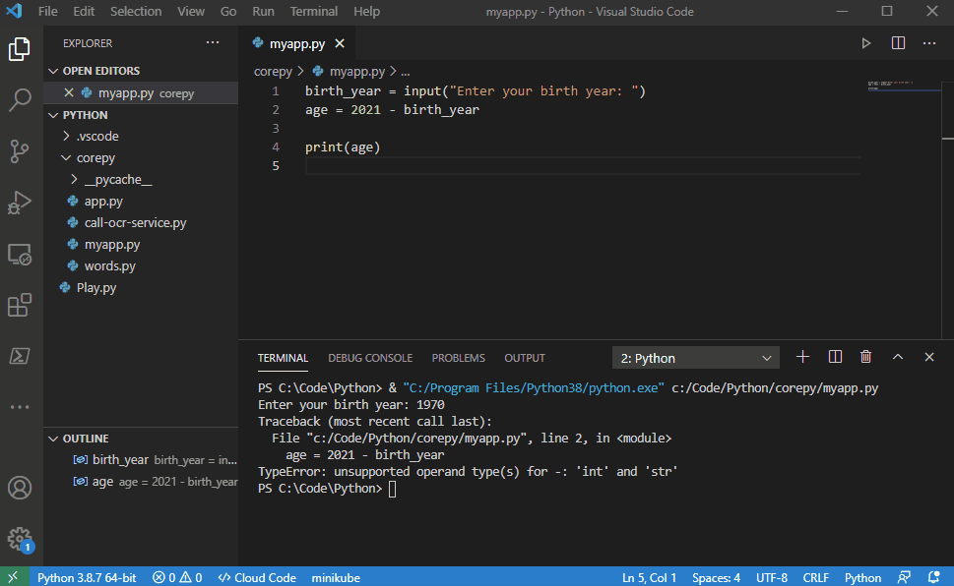
Data Types & Type Conversions - Continued
String to Integer Conversion
In the previous program we encountered a type conversion error. The reason the error occurred is because we tried to subtract a STRING from an INTEGER.
This is the same as trying to subtract the letter A from 10:
10 – “A” = ERROR
If you remember the input function accepts input from a user and returns the value entered as a STRING.
birth_year = input("Enter your birth year: ") (enter 1970) returns birth_year = ”1970” (the quotes denote that this is a STRING)
What we want is :
birth_year = 1970
In order to get the birth year in the correct data type (INTEGER) you have to convert the STRING representation of the number 1970 into an INTEGER.
Conversion Functions When working with data there will be times when you have to convert data from one type to another. To do this you use one of the data type conversion functions. See table at the bottom right.
Let’s update the code to convert the birth_year value to an INTEGER.
birth_year = input("Enter your birth year: ") age = 2021 - int(birth_year) print(age)
Re-run the program to see the result.
List of Conversion Functions
Function | Description
int() | Convert a value to an INTEGER.
float() | Converts a value to a FLOATing-point number (decimal number).
bool() | Converts a value to True or False (BOOLEAN).
str() | Convert a value to a STRING.

Slide 12
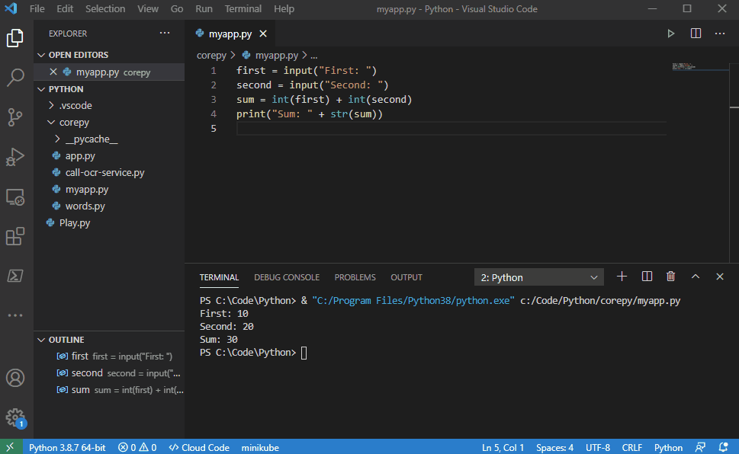
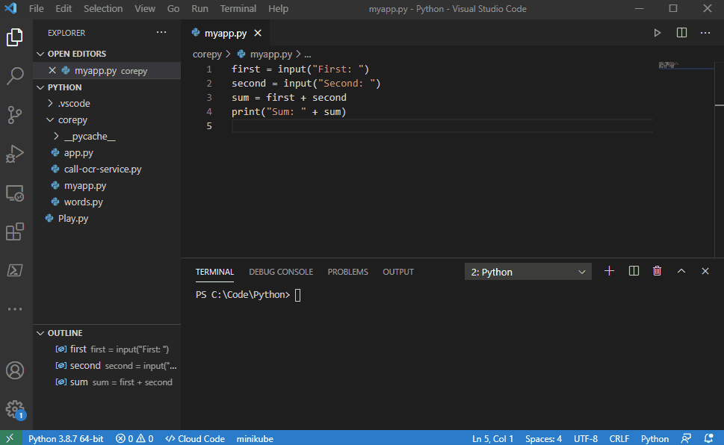
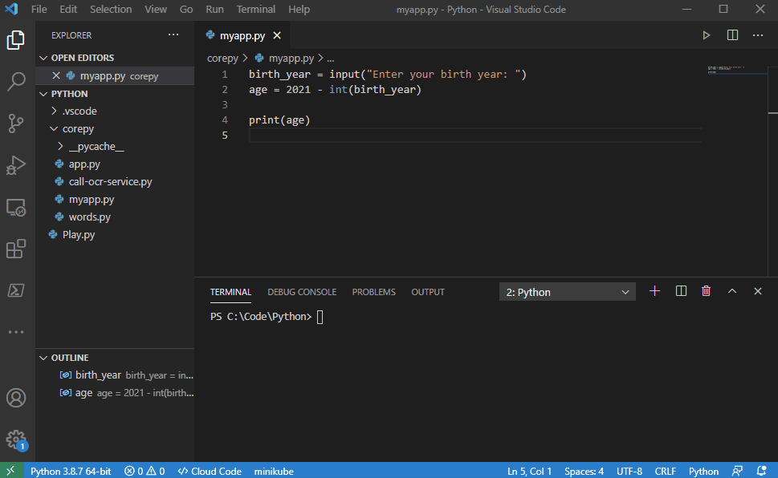
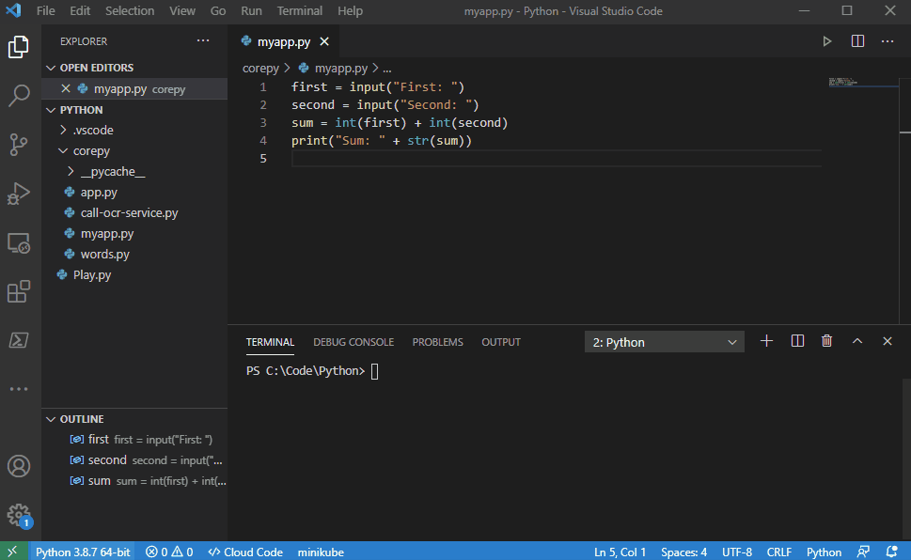
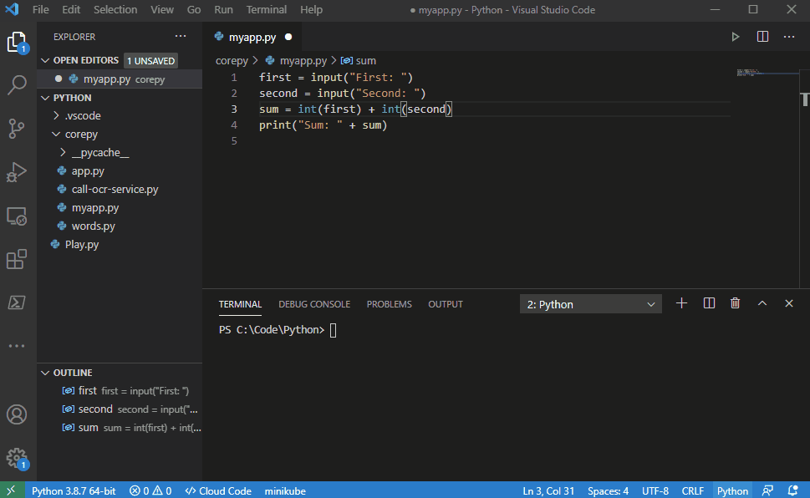
Exercise – Data Types & Type Conversions
Write a basic calculator
In this exercise you are to write a calculator program that will:
Accept input of a first number
Accept input of a second number
Output the sum of the two numbers
Use what you’ve learned to this point to complete this exercise.
Take 10 minutes….
Run your program again. This time use the following values:
First = 10.1
Second = 20
What was the result?
Notes:
1) First run probably produced the sum of two strings concatenated.
2) Second run probably produced an error when trying to concatenate a string and an integer/floats
3) Success with str function
Did anyone try to add decimal numbers? 10.1 + 20
4) Fourth run probably produced a value error where a float was entered then an attempt to convert float to an int caused error
5) Correct with float function instead of int. The float function will convert an int value to a float. The opposite would cause truncation of the value

Slide 13
Questions
????
Python Resources
Python Documentation - https://www.python.org/doc/
W3 Schools - https://www.w3schools.com/python/

